Slide 1
101/201 – Introductory Concepts and Applications
PowerShell

Slide 2
Agenda - 101
The PowerShell Language.
Integrated Scripting Environments.
Data Types.
Variables.
Logic and Loops.
Intro to Arrays.
Intro to Hash Tables.
Intro to Functions.

Slide 3
About PowerShell
Command Shell and Scripting Engine:
Accepts and returns .NET objects.
IntelliSense/Tab Completion.
Command Chaining.
Supports Functions, Classes, Scripts, Modules.
Dynamically Typed.
Cross platform.
Automation platform (Azure, VMWare, SQL, Windows, Etc.)
Desired State Configuration.
Supports Alias

Slide 4
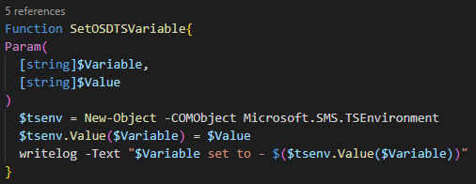
PowerShell Scripting Structure
PowerShell is Object Oriented.
Similar to Java/C# in structure code is grouped together using {}.
No end of line delimiter required.
Tab/spacing for readability.

Slide 5
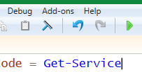

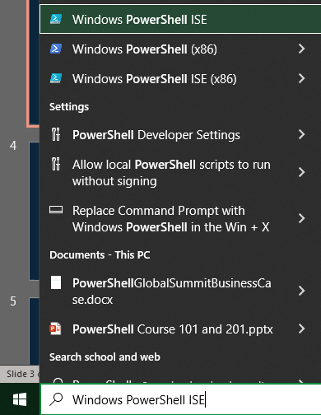
Integrated Scripting Environments – PowerShell ISE
Advantages:
Write, Test, and Debug in one place.
IntelliSense
Included in Windows (for now)

Slide 6
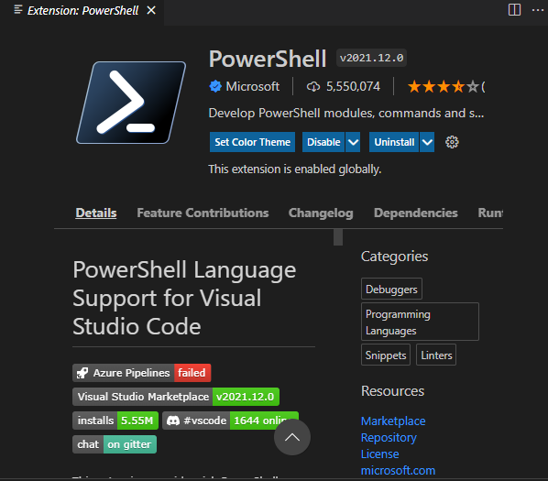
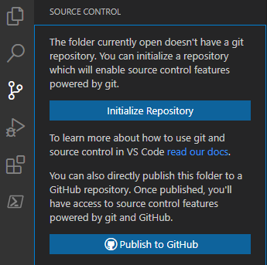
Integrated Scripting Environments – Visual Studio Code
Advantages:
Free: https://code.visualstudio.com
Extensible
Integrates with other platforms

Slide 7
Integrated Scripting Environments – Visual Studio Code
<DEMO>

Slide 8
Common Commandlets/Tips
Get-Help
Get-Member
.GetType()
Comments – # or <# #>
“ “ vs ‘ ‘

Slide 9
Data Types
Every value has a type, some common types:
[string] $string = “string”
[int] $int = 32
[char] $char = “A”
[single], [double], [decimal] (equivalent to float in some other languages) – single vs double vs decimal (size of number)
<Demo>
Notes:
Create a variable and use $variable.gettype() a bunch to show data types

Slide 10
Data Structures
An object/variable that contains multiple different data types or values:
[array] $array = @(1,2,3) or @(“Red”,”Blue”,”Green”)
[hashtable] $hash = @{} – key/value pair – example @{Number = 42; Shape = “Triangle”}
You don’t need to type your variables. PowerShell is robust enough (most of the time) to allow for dynamically typed variables
<Demo>
Notes:
Demo for typing:
$myVar = 1000
$myVar.GetType()
$myVar = “String”
$myVar.GetType()

Slide 11
Variables
“A container to hold a value, another variable, an object, a ‘thing’”
In PowerShell they are case InSenSativE
<Demo>
Notes:
Create a variable, show how it can contain multiple things, show how to ‘look’ in a variable with get-member
Show the case insensitivity.

Slide 12
Logic and Loops
If Statements and their flavours
If
If ElseIf
If Else Statements
For
While
Do / While
ForEach – Demo to come in Array / Hash Tables
<Demo>
Notes:
Show if, elseif, if else
Show for : for ($i=1; $i -le 10; $i++) {$i,"`n"}
Show while :
while(($inp = Read-Host -Prompt "Select a command") -ne "Q"){
switch($inp){
L {"File will be deleted"}
A {"File will be displayed"}
R {"File will be write protected"}
Q {"End"}
default {"Invalid entry"}
}
}
Show Do/While:
$i = 0
do{
write-host "$i"
$i = $i + 1
} while ($i -le 10)

Slide 13
Intro to Arrays
A list of things.
Can contain multiple different types.
Typically accessed by iterating through it, but no ‘easy’ way to look up an object by key (like a hash table)
Objects are in indexes.
Can have more than one dimension (talk through book analogy).
<DEMO>
Notes:
Build an array, and demo the foreach loop

Slide 14
Intro to Hash Tables
Can be ordered.
Sometimes called a dictionary.
Data stored in key value pairs.

Slide 15
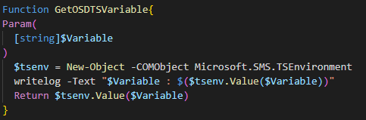
Intro to Functions
What is a function?
When do I use them and why?
Format
Approved verbs Approved Verbs for PowerShell Commands - PowerShell | Microsoft Docs

Slide 16
Resources
PowerShell in a month of lunches (Book) – Don Jones
Vendor Docs:
https://docs.microsoft.com/en-us/powershell/scripting/learn/ps101/00-introduction?view=powershell-7.2
https://docs.microsoft.com/en-us/powershell/scripting/lang-spec/chapter-01?view=powershell-7.2
Getting Started:
https://www.gngrninja.com/powershell-getting-started-series
Notes:
Create a variable, show how it can contain multiple things, show how to ‘look’ in a variable with get-member
Show the case insensitivity.

Slide 17
?
Notes:
Create a variable, show how it can contain multiple things, show how to ‘look’ in a variable with get-member
Show the case insensitivity.

Slide 18
Agenda - 201
Parameters.
Writing Functions.
Creating Custom Objects.
Using Hash tables.
String Manipulation.
APIs (Graph)
Error Handling.

Slide 19
Parameters
Something used by a script or a function to store a value. It’s a variable containing something.
Added using specific syntax
param(
[Parameter()]
[string]$Parameter1,
[Parameter()]
[string]$Parameter2
)
Can be optional or mandatory depending on their use.
Flexible.

Slide 20
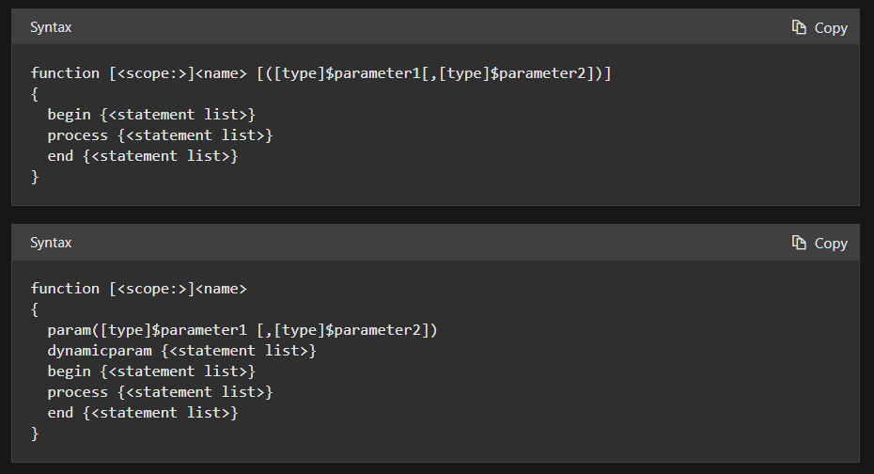
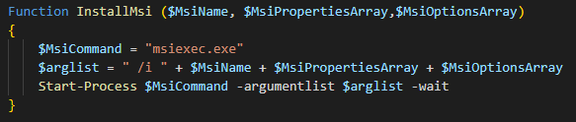
Functions
Recap the function slide from Part 1.
Different forms

Slide 21
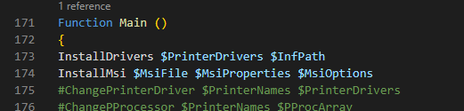
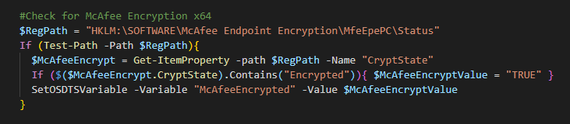
Functions Continued
Calling Functions.

Slide 22
Functions
<DEMO>
Notes:
Write a logging function
Function WriteLog() {
<#
.SYNOPSIS
This function logs activities to a text file. This file is appended to with each run of the script / each logging activity.
.DESCRIPTION
This function logs activities to a text file. This file is appended to with each run of the script / each logging activity. Log Path, Date and Time are set to default values of Get-Date and C:\Windows\Logs but can be overwritten using the parameters specified in the function. The tempError parameter must always be passed to the function.
.PARAMETER
$tempTime - Set to Get-Date, can be overwritten from pipeline.
$tempLogPath - Set to C:\Windows\Logs, can be overwritten from pipeline. - "$env:windir\Logs\BitLockerEnrollment.log"
$tempError - This is the value that you wish to log, error / success message, etc.
.EXAMPLE
No Example
.INPUTS
$tempError
.OUTPUTS
No outputs/returns, but does create a text file in the $tempLogPath file.
.NOTES
None
#>
Param(
[Parameter(Mandatory=$false,ValueFromPipeline=$True)]
[string]
$tempTime,
[Parameter(Mandatory=$False,ValueFromPipeline=$True)]
[string]
$tempLogPath,
[Parameter(Mandatory=$True,ValueFromPipeline=$True)]
[string]
$tempMessage,
[Parameter(Mandatory=$False,ValueFromPipeline=$False)]
[string]
$tempLogName=$ScriptName
)
$tempTime = get-date -UFormat "%m/%d/%Y - %R"
$tempLogPath = "C:\TeamsFix\" #"$env:windir\Logs\" - Format needs trailing slash, i.e., C:\temp\ -- this is correct
If(!(Test-path -Path "$tempLogPath")){
New-Item -Path "$tempLogPath" -ItemType "Directory"
}Else{
}
$tempTime + ' - ' + $tempMessage | Out-File -FilePath "$tempLogPath$tempLogName.log" -Append
}

Slide 23
Custom Objects
Why?
Great way to hold data and work with data.
Can contain anything you want / flexible.
Many different ways to create them.
$myObject = New-Object –TypeName psobject (legacy / slower / all versions of PS)
$myObject = [PSCustomObject]@{
Name = “Court”
Language = “PowerShell”
Province = “Alberta”
}
Both support Add-Member
$myObject | Add-Member –MemberType NoteProperty –Name “ID” –Value “001Court”

Slide 24
Custom Objects
<DEMO>

Slide 25
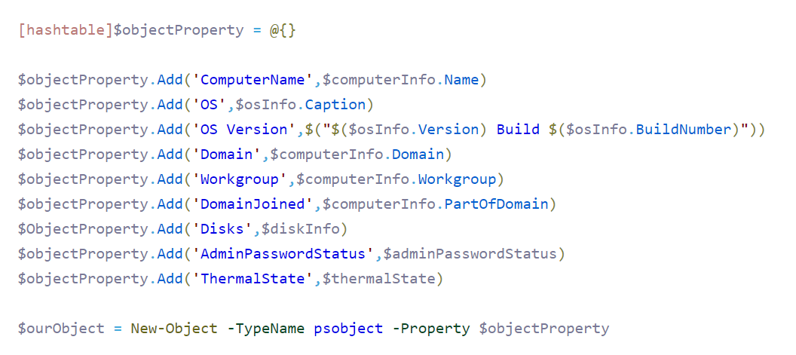
Hash Tables
Recap from 101
[hashtable]$hashTable = @{}
Interesting use for hash table is to populate a custom object:
<DEMO the above code>
Notes:
When using a hash table to add members to a custom object it doesn’t keep it in the same order, unlike add-member which does.

Slide 26
String Manipulation
Concatenating (Combining)
Splitting
Substrings
Searching/Replacing (light)
Comparison
Searching/Replacing/Manipulation (Regular Expressions – the Dark Side)

Slide 27
String Manipulation Demo (The Light Side)
<DEMO>

Slide 28
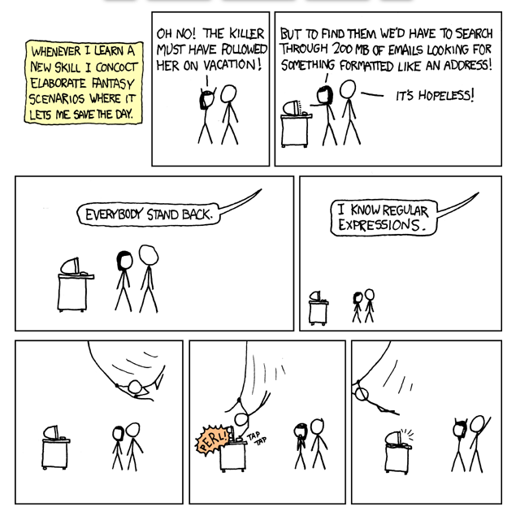
String Manipulation (The Dark Side)
<DEMO>
Comic from:
https://xkcd.com/208/
Notes:
#INITIAL - Matches on the pattern of an IP
$IPPattern = '(?:[0-9]{1,3}\.){3}[0-9]{1,3}'
$IPRange = $ListOfIPs | Select-String -Pattern $IPPattern -AllMatches
#INTERMEDIATE - Validates an Actually valid IP, but false positives are there (1.1.1.01 is accepted by this).
$IPPattern = '^((25[0-5]|2[0-4][0-9]|[01]?[0-9][0-9]?)\.){3}(25[0-5]|2[0-4][0-9]|[01]?[0-9][0-9]?)$'
$IPRange = $ListOfIPs | Select-String -Pattern $IPPattern -AllMatches
#FINAL - Validates an Actually valid IP
$IPPattern = '^(?:(?:25[0-5]|2[0-4][0-9]|1[0-9][0-9]|[1-9][0-9]|[0-9])\.){3}(?:25[0-5]|2[0-4][0-9]|1[0-9][0-9]|[1-9][0-9]|[0-9])$'
$IPRange = $ListOfIPs | Select-String -Pattern $IPPattern -AllMatches

Slide 29
APIs
Simplify the administration.
Using prepared format to interact
<DEMO>
Notes:
This is a loooooooooooooooooooooooooooooooooong one

Slide 30
Error Handling
Why?
Build more robust scripts / functions that are fault tolerant.
Avoid accidental bad outcomes.
Because it’s the professional thing to do.
$Error
Try{}, Catch{}, Finally
<DEMO>

Slide 31
Resources
https://docs.microsoft.com/en-us/powershell/scripting/overview?view=powershell-7.2
https://www.gngrninja.com/powershell-getting-started-series
https://devblogs.microsoft.com/scripting/
Powershell: The many ways to use regex (powershellexplained.com)
https://adamtheautomator.com
Members within Long View
Monthly Automation Community Meeting (Long View Internal)
Reach out to me (Courtney.marr@lvs1.com)

Slide 32
?
Notes:
Create a variable, show how it can contain multiple things, show how to ‘look’ in a variable with get-member
Show the case insensitivity.

